Slide 1
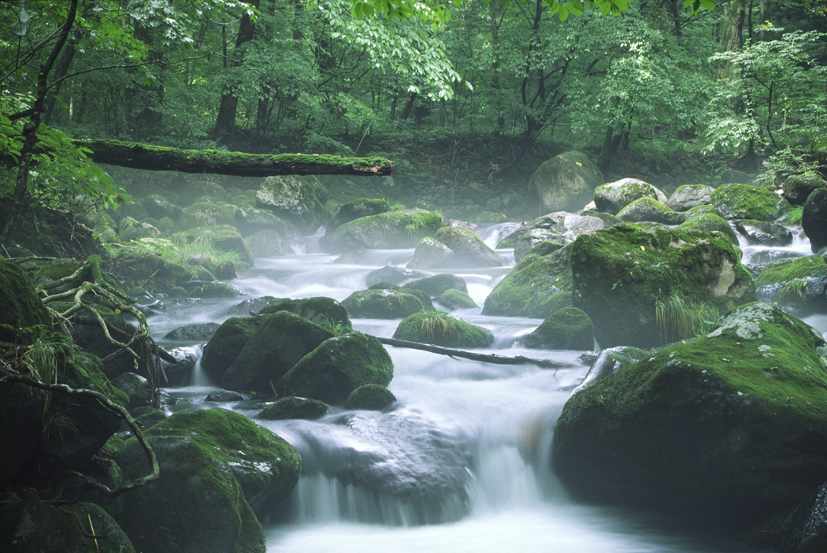
Review of Stream Riparian Condition in the West and South Coast Regions – Major Licensees
2006 - 2014

Slide 2
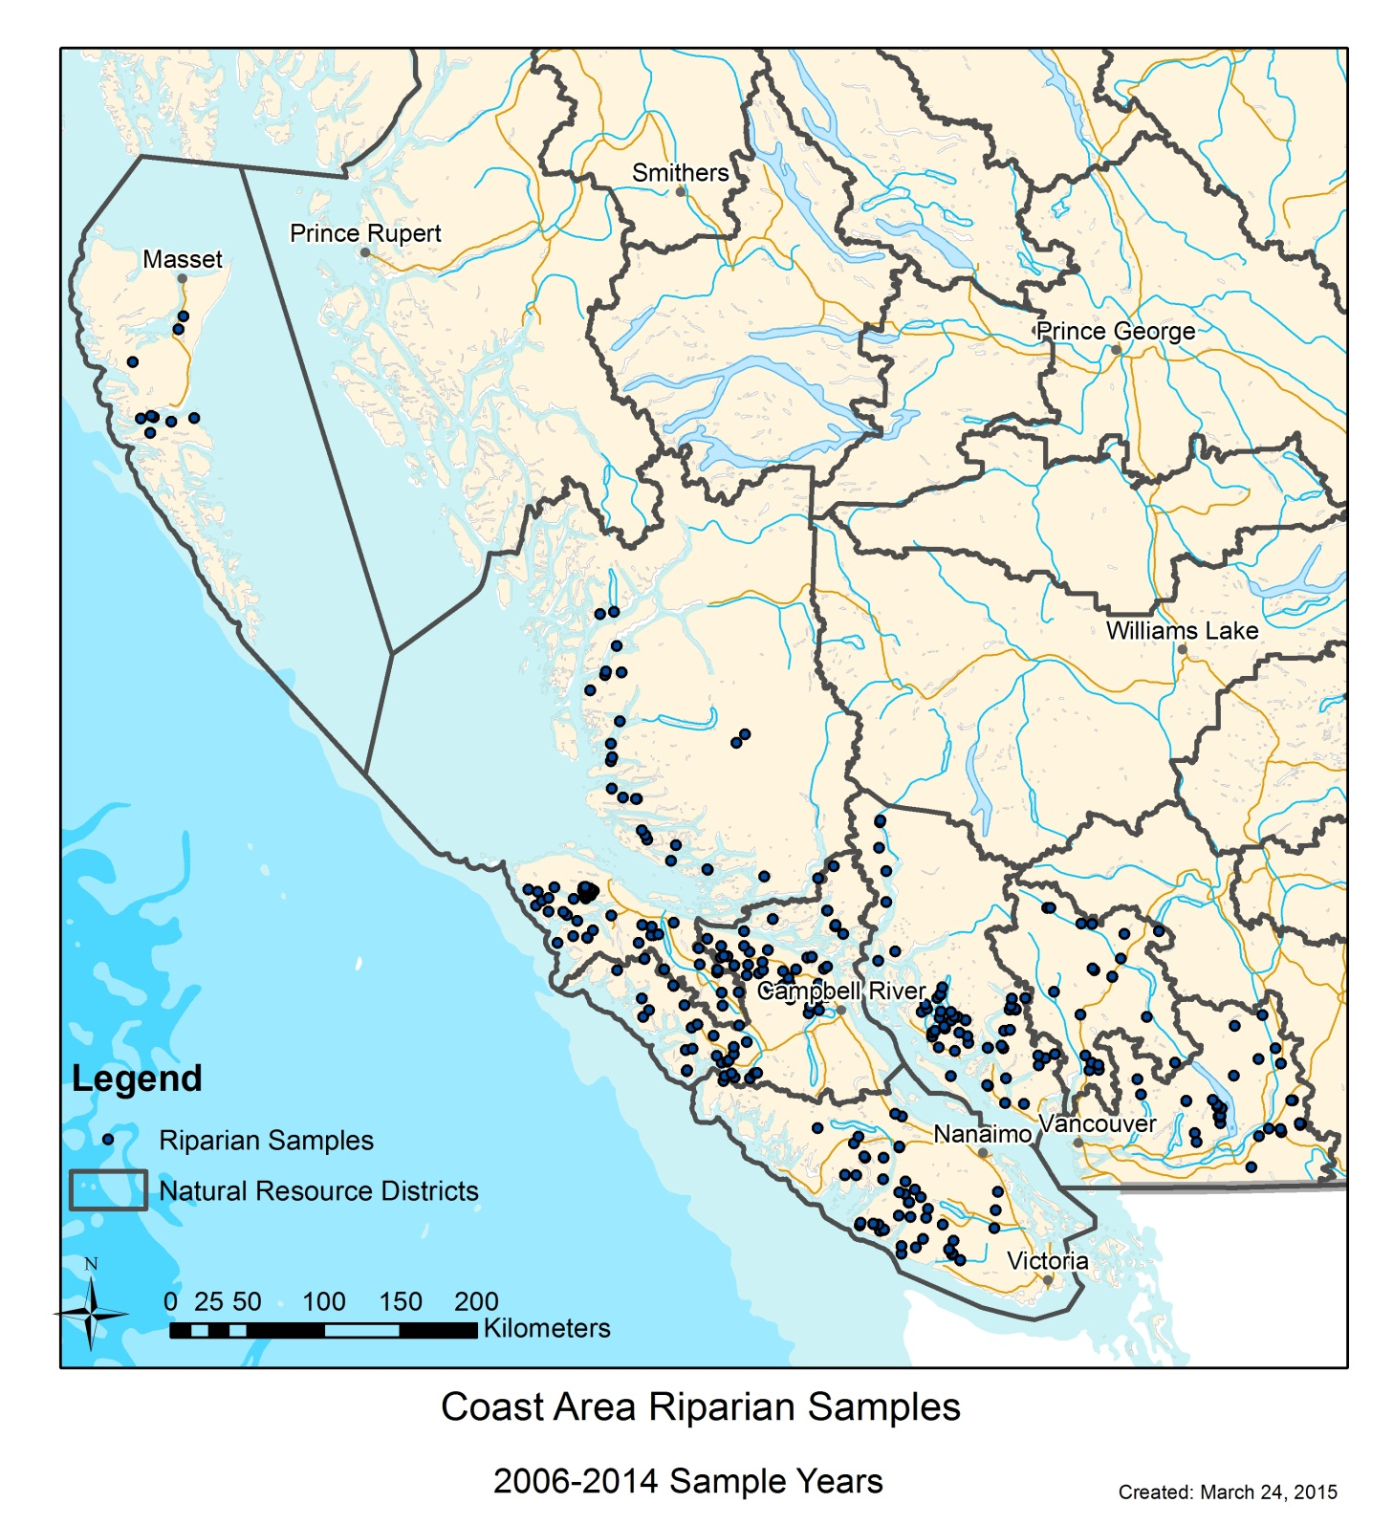
No. of Stream Reaches
Assessed (2006-2014)
South Coast Region n=120
  Chilliwack (n=37)
  Sunshine (n= 61)
  Sea-to-Sky (n=22)
  West Coast Region n=260
    South Island (n=54)
    Campbell River (n=84)
    North Island (n=108)
    Haida Gwaii (n=14)
Notes:
This map shows the distribution of all 360 stream reaches sampled from 2006 to the end of 2014 in or beside cutblocks logged by the four major licensees
260 in total in the West Coast region, mostly in the North Island District
120 in the South Cast region, most of them in the Sunshine Coast District

Slide 3
Stream Classes Sampled,
By Licensees W, X, Y, Z
Notes:
This graph shows the different stream classes sampled for each of the four major licensees. Clearly very little difference between licensees.
For most licensees, S6 streams were by far the most common stream sampled , followed by S5 streams, then S3 and S2 streams.
S4 streams were not that common for no known reasons.

Slide 4
Reference Stream Condition
Notes:
This slide summarizes the number of No answers for a sample of 51 reference streams in the FREP data.
Average number of “No” answers was 1.4, which is very similar to average number of Non-cut block related “No” answers (1.1) reported by Tschaplinski (2010) for the complete data set.
The distribution of No answers validates the number of No answers used to determine the different classes of Proper Functioning Condition in the previous slide
There were no streams not in PFC, though two streams did have serious impacts (slide/debris torrent, major flooding) to the stream channel

Slide 5
Magnitude of Impacts
No. of Stream/Riparian Attributes Affected | Stream/Riparian Condition (based on expert opinion and comparison to reference conditions) | Site Description | Impact Level
0-2 | PFC, no issues | Condition is similar to most reference stream conditions | Very Low
3-4 | PFC at risk, limited impacts | Overall condition within normal, range of natural variation, but some impacts present | Low
5-6 | PFC at high risk, impacts | Overall condition may not be in PFC, or close to NPF, obvious impacts present | Moderate
7+ | Not PF, numerous and/or severe impacts | Overall condition is outside normal range of natural variation | High
Notes:
This table shows how we assigned different levels of impact to a stream assessment.
The FREP riparian protocol assesses 15 different main attributes or processes of a stream reach and its riparian area.
When only two or fewer of these attributes are negatively impacted we say the reach is in Proper Functioning Condition (i.e. functioning properly), and the impacts overall are LOW.
As more and more attributes are negatively impacted, the stream is considered to be in progressively poorer condition.
When 7 or more attributes are negatively impacted, we say the impact on the reach and riparian area as a whole is HIGH
FREP “target” levels are green and light green

Slide 6
% of Samples with Low and Very Low Impacts, by Region
Notes:
This slide shows the % of all stream classes sampled with low or very low impacts, i.e. the green or light green outcomes in the previous slide equal to no more than 4 No answers on an assessment
From left to right, Skeena Region had good outcomes on 78% of the streams.
By comparison, South Coast and West Coast Regions had the lowest or close to the lowest scores with good outcomes on 62 and 56% of the streams respectively

Slide 7
Cause of Impacts by Region
Notes:
This graph summarizes both the average number of “No” answers recorded on stream assessments (all stream classes) and the relative importance of the main factors that affected the streams.
Overall the total number of No answers averages approx. 3.5, which is about an increase of 2-2.5 No answers due to human activities over the 1-1.5 No answers due to natural factors
Light blue at bottom of each bar are impacts due to natural factors such as floods, slides, windthrow, fire, and insect infestations. Note that the northeast region and the highest number of impacts due to natural factors. This was mainly because of the high natural sediment levels these streams have, a factor that was not taken into account because there were no data for that area when FREPstarted
As I pointed out earlier this averaged about 1.1 for the province as a whole.
Logging is the next and most significant factor, but before I go there I want to point out a couple of other note worthy factors
Impacts due to cattle are confined to the main cattle grazing regions of BC, i.e. TO, CC, and KA
“Other man-made” impacts are confined to the South Coast and West Coast regions – these are primarily impacts due to mtn. bike, quad, and motorcross trails, and invasive plants

Slide 8
% of Sample with High, Moderate Impacts, West and South Coast Regions
Notes:
This slide summarizes the % of streams sampled. The distribution was similar for all licensees

Slide 9
Results by Stream Class, All Licensees
Class | High | Medium | Low | V. low | Total
S1 | 0% | 0% | 1% | 0% | 1%
S2 | 0% | 2% | 2% | 5% | 9%
S3 | 1% | 1% | 4% | 6% | 12%
S4 | 1% | 1% | 2% | 1% | 5%
S5 | 2% | 3% | 3% | 10% | 17%
S6 | 13% | 16% | 14% | 12% | 56%
Total | 17% | 23% | 25% | 35% | 100%
Notes:
This Table summarizes the results by stream class.
If you look at the top four rows, you can see that relatively few (5-29%) of the S1-S4 stream classes are in the HIGH or MEDIUM impact categories
Results are very different for the S5 and especially the S6 streams classes. Here 41% of the S5 stream had a HIGH or MEDIUM impact, while 54% of the S6 streams had a HIGH or MEDIUM impact

Slide 10
Effects of Channel Width on
S6 Streams
Notes:
This graph shows improved outcomes as stream width increases. Seems clear that licensees are managing S6 streams on a finer scale than the FREP classifiication uses

Slide 11
Effects of Retention on S6 Streams
Notes:
This graph shows improved outcomes with higher retention levels.

Slide 12
Cause of Impacts – West Coast Region
% of time cited | Most common specific impact (in order of frequency)
Logging 74% Falling and yarding Low retention Windthrow | Stream or riparian blockages increased Large woody debris (LWD) processes altered Riparian vegetation decreased LWD supply decreased
Natural events 15% Wind High natural sediment levels | Stream or riparian blockages increased Moss levels decreased In-stream sediments increased
Roads 5% Erosion causing sedimentation and channel infilling | Stream or riparian blockages increased In-stream sediments increased
Upstream factors 5% Natural impacts logging | Moss levels decreased Stream or riparian blockages increased LWD processes altered
Notes:
This table comes right out of the riparian section of the MRVA report that was prepared for WFP. You can look at this table and fairly quickly see what the most common factors were causing impacts plus what the most common specific impacts were
It shows that logging was responsible for 75% of the negative outcomes in the West Coast region. Logging activities most frequently cited included falling and yarding, low retention and windthrow.
Specific stream or riparian attributes affected included in order of frequency blockages in the stream and riparian area, alteration of in-stream LWD processes, a decrease in riparian vegetation. And a decrease on the LWD supply
Natural events, roads and upstream factors were the other causes of the impacts recorded

Slide 13
Cause of Impacts – South Coast Region
% of time cited | Most common specific impact (in order of frequency)
Logging 72% Low retention, Falling and yarding | Riparian vegetation decreased Large woody debris (LWD) supply decreased LWD processes altered In-stream sediments increased
Natural events 12% Wind, Torrents | In-stream sediments increased Invertebrates decreased
Roads 12% Erosion causing sedimentation and channel infilling | In-stream sediments increased
Upstream factors 4% roads | In-stream sediments increased
Notes:
Here is the same table for the South Coast
Logging again is the most frequently cited cause of impacts, but mainly only because of falling and yarding and low retention. Windthrow was not as much an issue.
Natural events were about the same, while roads at 12% in the South Coast was a more frequent issue than the West Coast region at 5%.
Perhaps that also explains why higher instream sediment levels were much more frequently cited as a specific cause in the South coast compared to the West Coast

Slide 14
Summary
Small streams are ecologically important but this importance varies with size and flow characteristics, and linkages downstream
Recognize that a “one-size-fits-all” approach is not the best solutions for managing highly variable settings
The absence of a legal obligation for buffers is not permission to disregard all other ecological processes of functions of small fish or non-fish streams
Notes:
The end of a MRVA report on each FRPA value concludes with a short section on Opportunities for Improvement. The four main opportunities to improve outcomes on stream assessments are:
1)
2)
3)
4)
5)

Slide 15
Opportunities for Improvement
Continue to keep as many streams as possible outside or adjacent to cutblocks, or in WTPs
Maintain natural flow characteristics by minimizing introduction of logging debris
Retain non-merchantable and deciduous trees to fullest extent possible
Notes:
The end of a MRVA report on each FRPA value concludes with a short section on Opportunities for Improvement. The four main opportunities to improve outcomes on stream assessments are:
1)
2)
3)
4)
5)

Slide 16
Opportunities for Improvement
Increase retention and machine-free zones generally on in-block small streams, as per the FPC RMA Guidebook BMPs
Recognize extreme variability of “small” streams and the significance of the “wider”, perennial streams that make significant contributions of water, sediments, debris, nutrients, etc. to downstream fish habitats and watershed function
Notes:
The end of a MRVA report on each FRPA value concludes with a short section on Opportunities for Improvement. The four main opportunities to improve outcomes on stream assessments are:
1)
2)
3)
4)
5)

